Slide 1

Website Behavior Analysis
Fleena Christy

Slide 2
Business Problem Statement
Objective:
To optimize the user experience in an ecommerce web site and bringing in the insights based one the website browsing history of the customers to gauge e-commerce growth strategy effectiveness.
Benefits:
Understand the product funnel.
Avoid stockouts
Identify opportunities to boost revenue
Make better merchandising decisions
Understand and plan marketing efforts

Slide 3
Data Science Problem
Objective:
To build a predictive regression model which predict the probability of a user buying a product, based on the characteristics of user observed from the website browsing history data.
Benefits:
Identifying the potential customer
Optimize sales and returns
Avoid stockouts.
Optimize discounts

Slide 4
The Data
The Data Dictionary:
Timestamp - Time duration of customer using the website (Datatime)
UserID - User if of the customer (Int)
Website_section_visited - Website sections visited by the user (string)
Products_Purchased - Product purchased by the user (string)
Cart_Value - cart value of each customers(float)

Slide 5
The Solution Approach
1. Data Gathering
2. Data Cleaning
3. Feature Engineering / Feature Construction
4. Feature selection
5. Feature scaling
6. Model Building
7. Model Performance Evaluation
8. Model evaluation
9. Feature scope

Slide 6
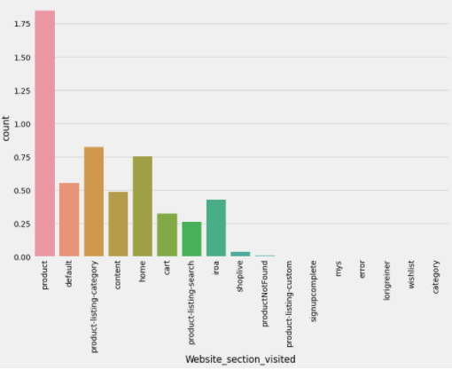
Exploratory Data Analysis
Data Cleaning:
Duplicate values are removed
Missing values are imputed
Completed EDA can be seen in the below page.

Slide 7
Feature Engineering
Features added:
Total Cart Value
Total Product Purchased
Total Time spent
No of time visited the site
Buying probability
User Rank/Score

Slide 8
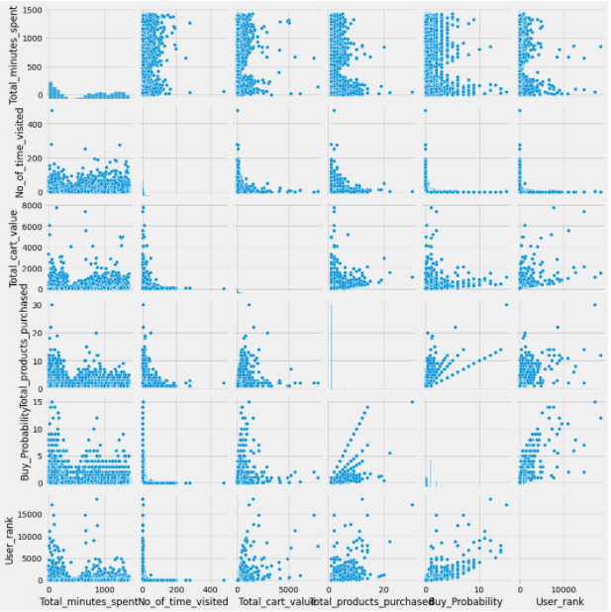
Data Visualization

Slide 9
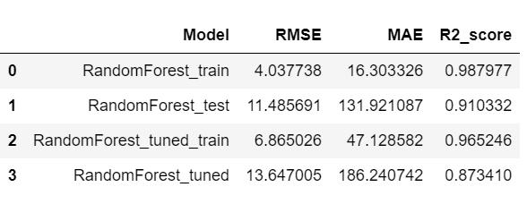
Model Building - Random Forest
Random forest Regressor is trained with different hyper parameters with 4 fold grid search for total 28000 records.

Slide 10
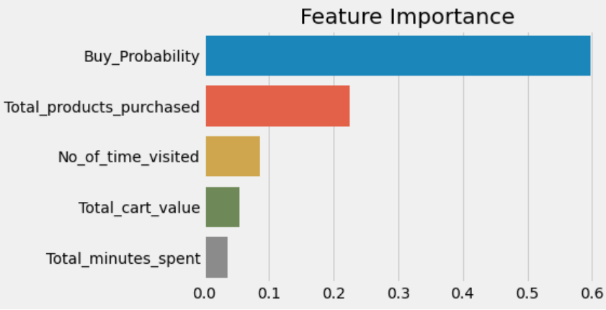
Feature selection
Feature Importance :
Buy Probability
Total_products_purchased
No_of_time_visited
Total_cart_value

Slide 11
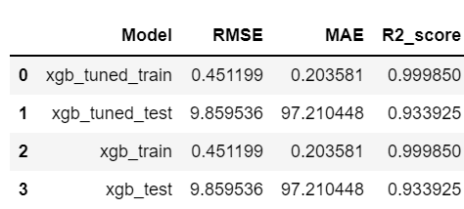
Module Tuning XGBoost
XGBoost Regressor is trained with different hyper parameters with 3 fold grid search.

Slide 12
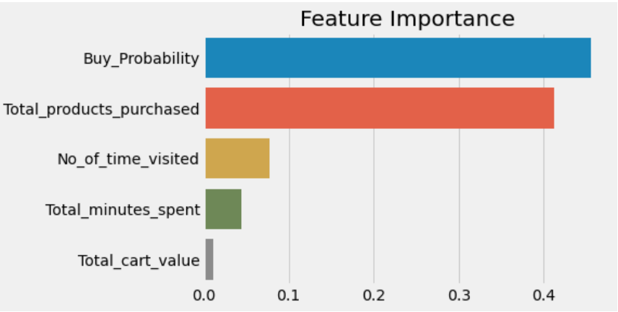
Feature selection
Feature Importance :
Buy_Probability
Total_products_purchased
No_of_time_visited
Total_cart_value

Slide 13
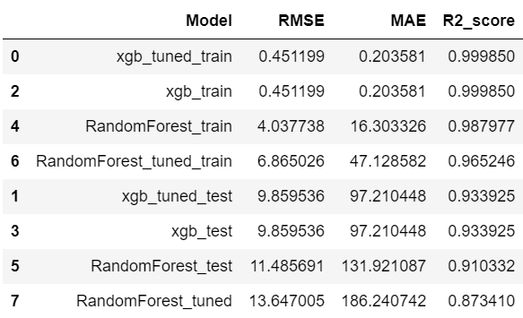
Model Comparison
Data is trained with Random forest and XGBoost.
Accuracy achieved – 99% with training data
93% with test data
We see some overfitting

Slide 14
Future Improvements
Future Improvements:
Need to find more features
Try with different hyperparameters.

Slide 15
Thank You

